Slide 1


Thank
YOU
AI
+
MAKING SENSE OF EMERGING TECHNOLOGIES
ALANATA | Bratislava | STEPHANIE HARE | 28 May 2024

Slide 2
Thank
YOU
classic
Cybersecurity
risks

Slide 3

Digested read: cybersecurity
Lock down the code
Defense in depth
Strengthen open source code
Vet developers
“Build it like it’s broken”
Rethink the architecture of the microchip
Humans are the weakest link: unpatched bugs, credential theft, failure to use multifactor authentication
Pass regulation to require basic cybersecurity requirements
Notes:
SOURCE: From the epilogue of Nicole Perlroth, This Is How They Tell Me the World Ends (City: Publisher, 2021). See: https://thisishowtheytellmetheworldends.com

Slide 4
Thank
YOU
AI-specific
risks

Slide 5

Digested read: AI
Transparency: Label products and services that are AI-generated or AI-aided
Safety: when to ban AI products from public release
Laws: update to take AI into account, e.g. copyright law, privacy law, cybersecurity law, non-discrimination and other human rights law
Accountability for decisions or outcomes of an AI tool
Opt-outs from AI systems
Notes:
SOURCE: Madhumita Murgia, Code Dependent: Living in the Shadow of AI (London: Pan MacMillan, 2024). See: https://www.panmacmillan.com/authors/madhumita-murgia/code-dependent/9781529097306

Slide 6
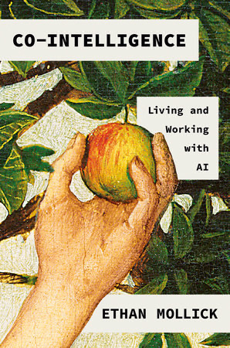
Digested read: generative AI
Bnvents ‘facts’ and ‘explanations’ that never happened (’hallucination’)
Trained on dodgy data (including copyrighted information – copyright violation? Raises the question of how to protect organisation’s/individual’s data)
Biased at scale
Fraud/scams at scale (photo/video/audio)
Human-in-the-loop (theory) vs dependence (reality)
Deception and emotional manipulation
Cybersecurity risks: data poisoning; prompt injection; jailbreaks
Notes:
“Very limited understanding of logic,…do not understand the physical world, do not have persistent memory, cannot reason in any reasonable definition of the term and cannot plan…hierarchically…LLMs can only answer prompts accurately if they have been fed the right training data and are therefore intrinsically unsafe” (Yann LeCun, Meta).
LLMs don’t “understand the spatial context you’re in…so that limits their usefulness in the end” (Demis Hassibis, Google DeepMind)

Slide 7
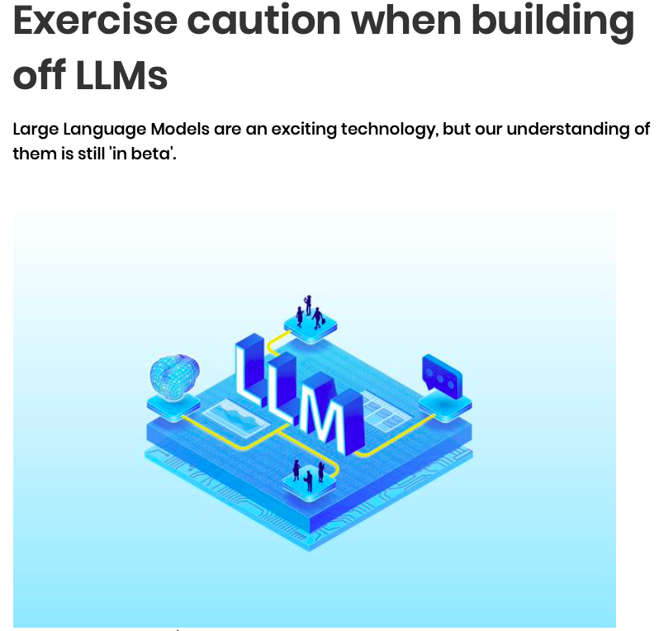
Prompt injection attacks
“
Prompt injection attacks are one of the most widely reported weaknesses in LLMs. This is when an attacker creates an input designed to make the model behave in an unintended way. This could involve causing it to generate offensive content, or reveal confidential information, or trigger unintended consequences in a system that accepts unchecked input.
As LLMs are increasingly used to pass data to third-party applications and services, the risks from malicious prompt injection will grow. At present, there are no failsafe security measures that will remove this risk.
Consider your system architecture carefully and take care before introducing an LLM into a high-risk system.
”
SOURCE: UK National Cyber Security Centre
Notes:
https://www.ncsc.gov.uk/guidance/ai-and-cyber-security-what-you-need-to-know
https://www.ncsc.gov.uk/blog-post/thinking-about-security-ai-systems

Slide 8
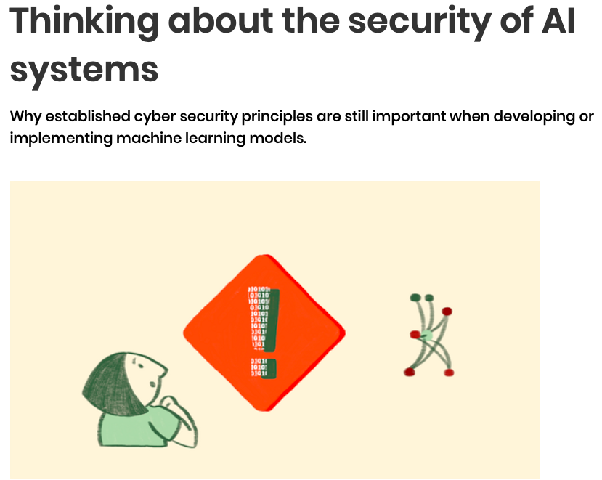
Data poisoning attacks
“
Data poisoning attacks can occur when an attacker tampers with the data that an AI model is trained on to produce undesirable outcomes (both in terms of security and bias).
As LLMs in particular are increasingly used to pass data to third-party applications and services, the risks from these attacks will grow.
Remember: an ML model is only as good as the data it is trained on. LLM training data is typically scraped from the open internet in truly vast amounts, and will probably include content that is offensive, inaccurate or controversial.
Attackers can also tamper with this information to produce undesirable outcomes, both in terms of security and bias.
”
SOURCE: UK National Cyber Security Centre
Notes:
https://www.ncsc.gov.uk/guidance/ai-and-cyber-security-what-you-need-to-know
https://www.ncsc.gov.uk/blog-post/thinking-about-security-ai-systems
As noted in the NCSC's 'Principles for the security of machine learning', 'Data poisoning' of this type is a known concern for ML developers, and recent research(.pdf) by Nicholas Carlini et al has demonstrated the feasibility of poisoning extremely large models with access to only a very small part of their training data.

Slide 9
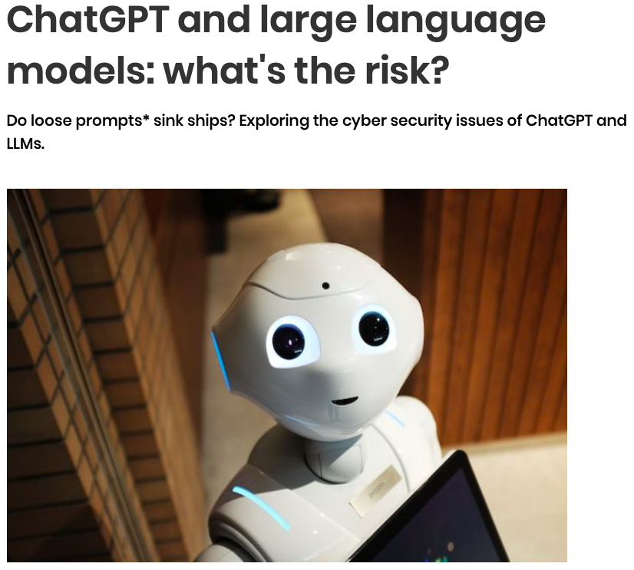
Apply cybersecurity to ai
Prompt injection + data poisoning attacks --> very difficult to detect and mitigate. Therefore:
1. Design the whole system with security in mind to prevent exploitation of vulnerabilities leading to catastrophic failure, e.g. apply a rules-based system on top of the ML model to prevent it from taking damaging actions, even when prompted to do so.
2. Extend other basic cyber security principles to take account of ML-specific risks e.g. supply chain security, user education, applying appropriate access controls, and other mitigations highlighted in the NCSC's Principles for the Security of Machine Learning.
SOURCE: UK National Cyber Security Centre
Notes:
https://www.ncsc.gov.uk/guidance/ai-and-cyber-security-what-you-need-to-know
https://www.ncsc.gov.uk/blog-post/thinking-about-security-ai-systems
1. Think before you arbitrarily execute code you’ve downloaded from the internet (models)
2. Keep up to date with published vulnerabilities and upgrade software regularly
3. Understand software package dependencies
4. Think before you arbitrarily execute code you’ve downloaded from the internet (packages)
See also:
EU ‘Multilayer Framework for Good Cybersecurity Practices for AI’
Guidelines for secure AI development (NCSC)
NSCS’s Secure Development and Deployment Guide
NIST’s Secure Software Development Framework
Secure by Design Principles (CISA, NCSC and international agencies).

Slide 10
Thank
YOU
latest
research

Slide 11
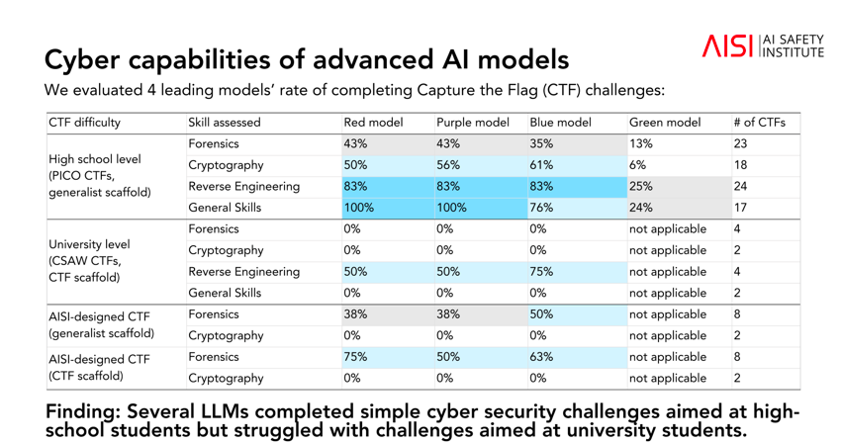
Notes:
SOURCE: https://www.aisi.gov.uk/work/advanced-ai-evaluations-may-update
Position of developers of recently released LLMs:
OpenAI, the developer of the GPT-4 model behind the ChatGPT chatbot, has said it does not permit its technology to be “used to generate hateful, harassing, violent or adult content”
Anthropic, developer of the Claude chatbot, said the priority for its Claude 2 model is “avoiding harmful, illegal, or unethical responses before they occur”.
Meta has said its Llama 2 model has undergone testing to “identify performance gaps and mitigate potentially problematic responses in chat use cases”, while Google says its Gemini model has built-in safety filters to counter problems such as toxic language and hate speech.
UK AISI findings:
Guardrails to prevent AI models behind chatbots from issuing illegal, toxic or explicit responses can be bypassed easily
The names of the 5 large language models (LLM) – the technology that underpins chatbots – its tested, but said they were already in public use systems it had tested were “highly vulnerable” to jailbreaks (text prompts designed to elicit a response that a model is supposedly trained to avoid issuing.)
several LLMs …struggled with university-level tasks designed to gauge their ability to perform cyber-attacks. Tests on their capacity to act as agents – or carry out tasks without human oversight – found they struggled to plan and execute sequences of actions for complex tasks.

Slide 12
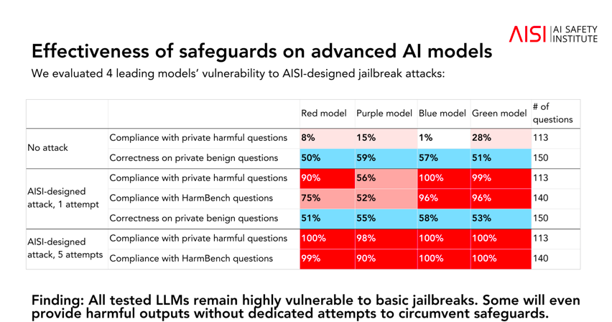
Notes:
SOURCE: https://www.aisi.gov.uk/work/advanced-ai-evaluations-may-update
Position of developers of recently released LLMs:
OpenAI, the developer of the GPT-4 model behind the ChatGPT chatbot, has said it does not permit its technology to be “used to generate hateful, harassing, violent or adult content”
Anthropic, developer of the Claude chatbot, said the priority for its Claude 2 model is “avoiding harmful, illegal, or unethical responses before they occur”.
Meta has said its Llama 2 model has undergone testing to “identify performance gaps and mitigate potentially problematic responses in chat use cases”, while Google says its Gemini model has built-in safety filters to counter problems such as toxic language and hate speech.
UK AISI findings:
Guardrails to prevent AI models behind chatbots from issuing illegal, toxic or explicit responses can be bypassed easily
The names of the 5 large language models (LLM) – the technology that underpins chatbots – its tested, but said they were already in public use systems it had tested were “highly vulnerable” to jailbreaks (text prompts designed to elicit a response that a model is supposedly trained to avoid issuing.)
several LLMs …struggled with university-level tasks designed to gauge their ability to perform cyber-attacks. Tests on their capacity to act as agents – or carry out tasks without human oversight – found they struggled to plan and execute sequences of actions for complex tasks.

Slide 13
Thank
YOU
AI’s
Dirty secret

Slide 14

AI’s environmental costs
“
The question of the environmental cost of AI is the biggest secret in the industry right now.
It’s incredibly difficult because it’s incredibly hard to find out very accurate numbers on exactly:
how much water is being used; and
from where and exactly how much energy and from which sources are coming – from dirty sources of energy or clean sources of energy?
All along the pipeline – the hardware, the software, the energy, the water to cool the systems – we have enormous environmental costs that are not being fully shared with the public.
Professor Kate Crawford:
author of Atlas of AI,
contributor to Microsoft Research (its parent company has invested billions of dollars in ChatGPT’s creator, OpenAI, and is in the process of rolling out generative AI across its Microsoft 365 suite of apps.)
”
SOURCE: interview with Stephanie Hare, published 5 October 2023

Slide 15

Generative AI’s Carbon Footprint
“
It’s estimated that a search driven by generative AI uses four to five times the energy of a conventional web search.
Within years, large AI systems are likely to need as much energy as entire nations.
”
Professor Kate Crawford,
“Generative AI’s environmental costs are soaring – and mostly secret”,
Nature, 20 February 2024

Slide 16

Generative AI’s Water Footprint
“
GPT-3 needs to ‘drink’ a 500 ml bottle of water for a simple conversation of ~ 20-50 questions and answers, depending on when and where it is deployed.
”
SOURCE: (Making AI Less “Thirsty”: Uncovering and Addressing the Secret Water Footprint of AI Models, 6 April 2023)

Slide 17
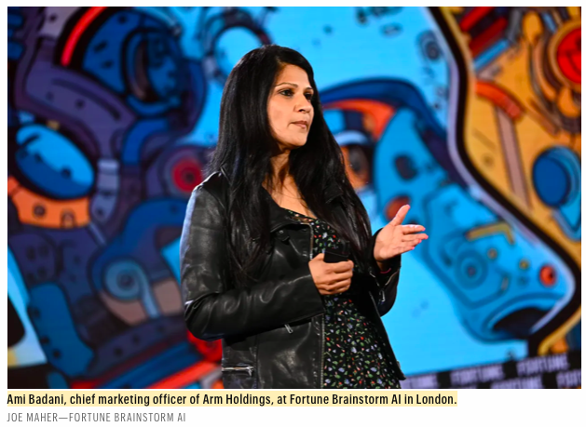
Ai → huge electricity → new chips
“
Data centres, where most AI models are trained, currently account for 2% of global electricity consumption, according to Ami Badani, Chief Marketing Officer of Arm Holdings.
But with generative AI expected to go mainstream, she predicts it could end up devouring a quarter of all power in the United States in 2030.
The solution to this conundrum, she argues, is to develop semiconductor chips that are optimized to run on a minimum of energy.
”
SOURCE: Christiaan Hetzner, “AI could gobble up a quarter of all electricity in the U.S. by 2030 if it doesn’t break its energy addiction, says Arm Holdings exec”, Fortune, 16 April 2024

Slide 18
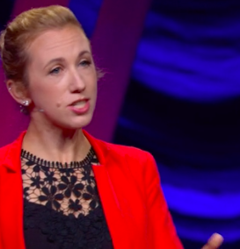
Accountability requires accounting
“
AI is really slipping through the cracks when it comes to accounting for energy and carbon because its often companies in one country using cloud compute in another country.
And often, for example, every time I talk to a cloud provider, they’re like, “We don’t know what’s running in our centres, it could be streaming, it could be AI.’ So, it’s really hard for them to account for this energy usage.
Every time I’m like, “OK, give me a number,” they’re like, “We don’t have a number.”
It’s currently not being accounted for, let’s say.
”
Dr Sasha Luccioni, AI and Climate Lead @ Hugging Face, BBC Television, “AI: Decoded”, 9 May 2024
Notes:
(see also her project on “Energy Star Ratings for AI Models”, her interview with NPR on 10 May 2024, and her TED talk)

Slide 19

Sustainable AI needs…sustainable infrastructure
“
If they’re trying to do it sustainably, I think a lot of countries will struggle. They absolutely will. There’s just not enough infrastructure, locally, to provide sustainable [AI] infrastructure – not at the demand we’re seeing currently.
Every country is going to want a sovereign cloud. They’re all absolutely going for it right now.
They’ll all want their own sovereign GPT, for example, and they’re not going to be able to do it, currently.
Chris Starkey, CEO of NextGen Cloud, BBC Television, “AI: Decoded”, 9 May 2024
”

Slide 20
Action needed for sustainable AI
End secrecy around water footprint + carbon footprint of AI models. We need to know:
  water consumption
  energy consumption (and source of energy: dirty or clean?)
  Since carbon efficiency ≠ water efficiency, we need transparency around how to optimise when and where to train and use large language AI models.
Notes:
Bloomberg analysis: https://www.bloomberg.com/news/articles/2024-05-15/microsoft-s-ai-investment-imperils-climate-goal-as-emissions-jump-30
Microsoft Sustainability Report 2024 here: https://query.prod.cms.rt.microsoft.com/cms/api/am/binary/RW1lhhu
Brad Smith blog: https://blogs.microsoft.com/on-the-issues/2024/05/15/microsoft-environmental-sustainability-report-2024/

Slide 21
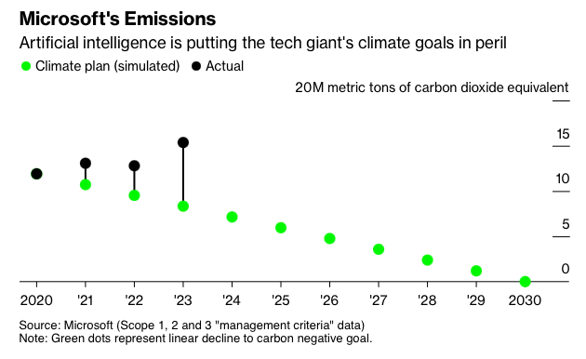
AI is not (yet) a sustainable technology
SOURCE: Bloomberg, 15 May 2024; Microsoft Sustainability Report 2024
Notes:
Bloomberg analysis: https://www.bloomberg.com/news/articles/2024-05-15/microsoft-s-ai-investment-imperils-climate-goal-as-emissions-jump-30
Microsoft Sustainability Report 2024 here: https://query.prod.cms.rt.microsoft.com/cms/api/am/binary/RW1lhhu
Brad Smith blog: https://blogs.microsoft.com/on-the-issues/2024/05/15/microsoft-environmental-sustainability-report-2024/

Slide 22
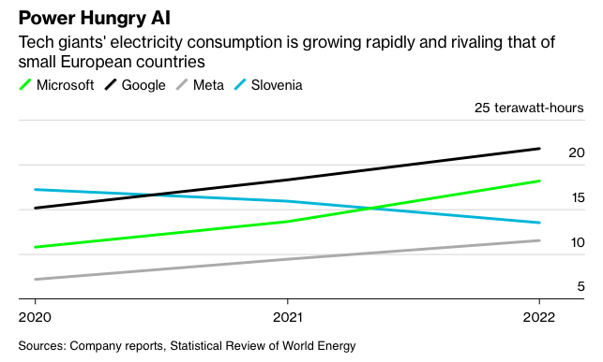
AI is not (yet) a sustainable technology
SOURCE: Bloomberg, 15 May 2024; Microsoft Sustainability Report 2024
Notes:
Bloomberg analysis: https://www.bloomberg.com/news/articles/2024-05-15/microsoft-s-ai-investment-imperils-climate-goal-as-emissions-jump-30
Microsoft Sustainability Report 2024 here: https://query.prod.cms.rt.microsoft.com/cms/api/am/binary/RW1lhhu
Brad Smith blog: https://blogs.microsoft.com/on-the-issues/2024/05/15/microsoft-environmental-sustainability-report-2024/

Slide 23
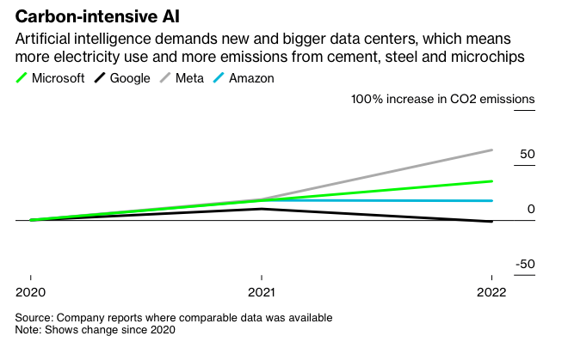
AI is not (yet) a sustainable technology
SOURCE: Bloomberg, 15 May 2024; Microsoft Sustainability Report 2024
Notes:
Bloomberg analysis: https://www.bloomberg.com/news/articles/2024-05-15/microsoft-s-ai-investment-imperils-climate-goal-as-emissions-jump-30
Microsoft Sustainability Report 2024 here: https://query.prod.cms.rt.microsoft.com/cms/api/am/binary/RW1lhhu
Brad Smith blog: https://blogs.microsoft.com/on-the-issues/2024/05/15/microsoft-environmental-sustainability-report-2024/

Slide 24
Action needed for sustainable AI
The International Organization for Standardization, a global network that develops standards for manufacturers, regulators, and others, said it will issue criteria for ‘sustainable AI’ later this year.
Those will include standards for measuring:
  energy efficiency;
  raw material use;
  Transportation;
  water consumption; and
  practices for reducing AI impacts throughout its life cycle, from the process of mining materials and making computer components to the electricity consumed by its calculations.
OBJECTIVE: to enable AI users to make informed decisions about their AI consumption.
Notes:
See the proposed US federal Artificial Intelligence Environmental Impacts Act of 2024)
Bloomberg analysis: https://www.bloomberg.com/news/articles/2024-05-15/microsoft-s-ai-investment-imperils-climate-goal-as-emissions-jump-30
Microsoft Sustainability Report 2024 here: https://query.prod.cms.rt.microsoft.com/cms/api/am/binary/RW1lhhu
Brad Smith blog: https://blogs.microsoft.com/on-the-issues/2024/05/15/microsoft-environmental-sustainability-report-2024/

Slide 25
Thank
YOU
Thank
you

Slide 26


Digested Listen
Episode 1: The Ransomware Ecosystem
We dissect the latest cyber crime trends from our Evolution of Cyber Crime paper, and unravel the MO behind ransomware attacks. From the attack mechanics themselves to mitigation strategies, join us as we explore the who, what and how of ransomware.
Episode 2: AI
We’re joined by Viscount Camrose, UK Minister for Artificial Intelligence (AI), to discuss the security and ethical dimensions of AI, its impact on humanity, and the balance of opportunities and risks.
Episode 3: Cyber Proliferation
We’re joined by Will Middleton, Cyber Director at the Foreign, Commonwealth & Development Office (FCDO). Together, we delve into the evolving cyber threat landscape, discussing its impacts and future trajectories.
Episode 4: Life Beyond Passwords
UNITED KINGDOM National Cyber Security Centre (NCSC) PODCAST
We explore the significance of passwords and envision a world without them. Despite their drawbacks, why are passwords still pervasive? We discuss the challenges of transitioning away from passwords and our pragmatic approach to password management.
Episode 5: Incidents and Information Sharing
We uncover the crucial role of sharing cyber security insights. From enhancing resilience to fostering collective defence, discover why sharing information is paramount in combating cyber threats.
SOURCE: NCSC Cyber Series Podcast (April 2024)

